Slide 1

MODY UNIVERSITY OF SCIENCE AND TECHNOLOGY
SCHOOL OF ENGINEERING AND TECHNOLOGY
Database Management Systems Lab
CS 14.224
PROJECT BASED LEARNING
PHASE-III
SUBMITTED TO –
Mr. Manmohan Sharma
Mr. Siddhant Singh
SUBMITTED BY –
Simran Jain(180181)
Akshita Kanther(180161)
Hiral Jain(180167)
Nidhi Choudhary(180074)

Slide 2
COLLEGE FEST MANAGEMENT SYSTEM

Slide 3
contents
Introduction
Description
Concepts Used
Languages and Tools used
Output Screens
Bibliography

Slide 4
introduction
This project is about College Fest Management System. This includes about various pages consisting register, login, type of fest , events information, fee details , billing system, participation in various events, participants information, coordinators details ,etc. In this system user and admin will be given different access priorities through which they can access various modules/pages .
Through this system students can easily figure out their area of interest and participate in various events. Admin will be able to manage all the data very easily will the help of databases and tables.

Slide 5
description
FRONT END
PROGRAM
LOGIC
DATABASE
3 TIER ARCHITECTURE

Slide 6
HOME PAGE
This page consists of various modules:-
On this page firstly user will register and select the type of fest and further on the next page information of various events will be displayed and then on next page coordinators and fee details will be shown. These pages can be accessed by both user and admin.
Register
And
Type of Fest
Events Information
Coordinators Details
And
Fee Details

Slide 7
ADMIN PAGE
This page consists of various modules:-
As per the name suggests, only admin is able to access these modules as accessing permissions are granted to admin only.
Participants Information
Participation in various events
Billing system will also be included . Admin can access whole summary of billing system for various events. Every registered individual(user) can check his/her bill summary .

Slide 8
Concepts used
E-R Diagrams
Database Designing
Constraints
SQL Queries

Slide 9
Entity-Relationship Diagram for College fest Management

Slide 10
Password
Username
ID
ADMIN
Permission
Colg_name
Payment
to
COLLEGE
Date_of_reg
Register
Event_schedule
Email_id
Username
Contact
_no
City
Contact_no
Name
Email_id
Get
SCHEDULE
STUDENT
EVENT
Volunteer
Username
Address
ID
Name
State
Password
Email_id
Event_Type
Date
City
Day
Time
Gender
Contact_no
Street
Non_tech
Month
Year
Tech

Slide 11
Languages and tools used
Server –Xampp (free open source ,cross platform, web server package developed by
Apache for testing and deployment purposes).
Server application- Apache (web server)
Languages-HTML ,CSS ,PHP(for designing and program development purpose)
Database-MYSQL (used for storing data related to various organisations)
IDE(Integrated Development Environment)-Notepad++

Slide 12
HTML &CSS terminoloGies used in project:-
The <!DOCTYPE html> declaration defines this document to be HTML5
The <html> element is the root element of an HTML page
The <head> element contains meta information about the document
The <title> element specifies a title for the document
The <body> element contains the visible page content
The <h1> to <h6> element defines heading according to their font-size.
The <p> element defines a paragraph

Slide 13
HTML links are defined with the <a> tag.
The link's destination is specified in the href attribute.
Eg- <a href="https://www.w3schools.com">This is a link</a>
HTML images are defined with the <img> tag.
The source file (src), alternative text (alt), width, and height are provided as attributes
<img src="w3schools.jpg" alt="W3Schools.com" width="104" height="142">
HTML lists are defined with the <ul> (unordered/bullet list) or the <ol> (ordered/numbered list) tag, followed by <li> tags (list items).
HTML elements with no content are called empty elements.
<br> is an empty element without a closing tag (the <br> tag defines a line break).
Attributes provide additional information about an element.
Attributes are always specified in the start tag.
Attributes usually come in name/value pairs like: name="value“.

Slide 14
HTML links are defined with the <a> tag. The link address is specified in the href attribute:
Example
<a href="https://www.w3schools.com">This is a link</a>
The style Attribute
The style attribute is used to specify the styling of an element, like color, font, size etc.
Example
<p style="color:red">This is a paragraph.</p>
Setting the style of an HTML element, can be done with the style attribute.
The HTML style attribute has the following syntax:
<tagname style="property:value;">
The property is a CSS property. The value is a CSS value.

Slide 15
We use the style attribute for styling HTML elements.
We use background-color for background color.
We use color for text colors.
We use font-family for text fonts.
We use font-size for text sizes.
We use text-align for text alignment.
We use the CSS border property for borders.
Use the CSS padding property for space inside the border.
Use the CSS margin property for space outside the border

Slide 16
RGBA Value-
RGBA color values are an extension of RGB color values with an alpha channel - which specifies the opacity for a color.
An RGBA color value is specified with:
rgba(red, green, blue, alpha)
The alpha parameter is a number between 0.0 (fully transparent) and 1.0 (not transparent at all).
HTML Links - The target Attribute
The target attribute specifies where to open the linked document.
The target attribute can have one of the following values:
_blank - Opens the linked document in a new window or tab.
framename - Opens the linked document in a named frame.

Slide 17
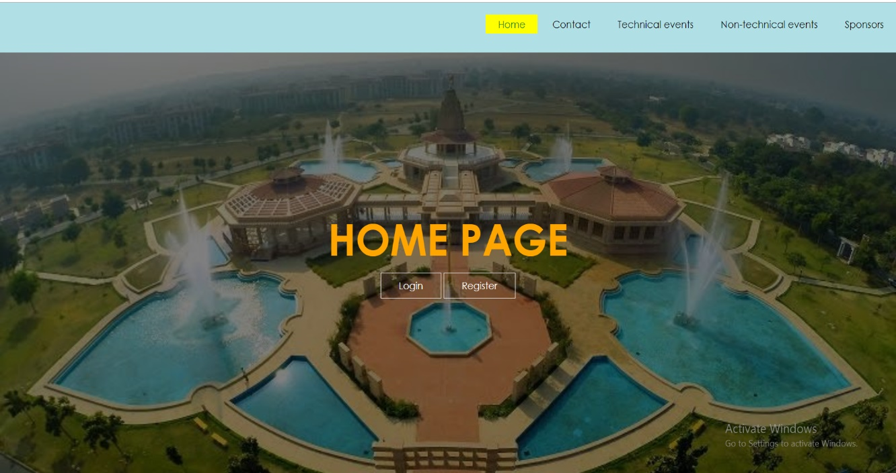
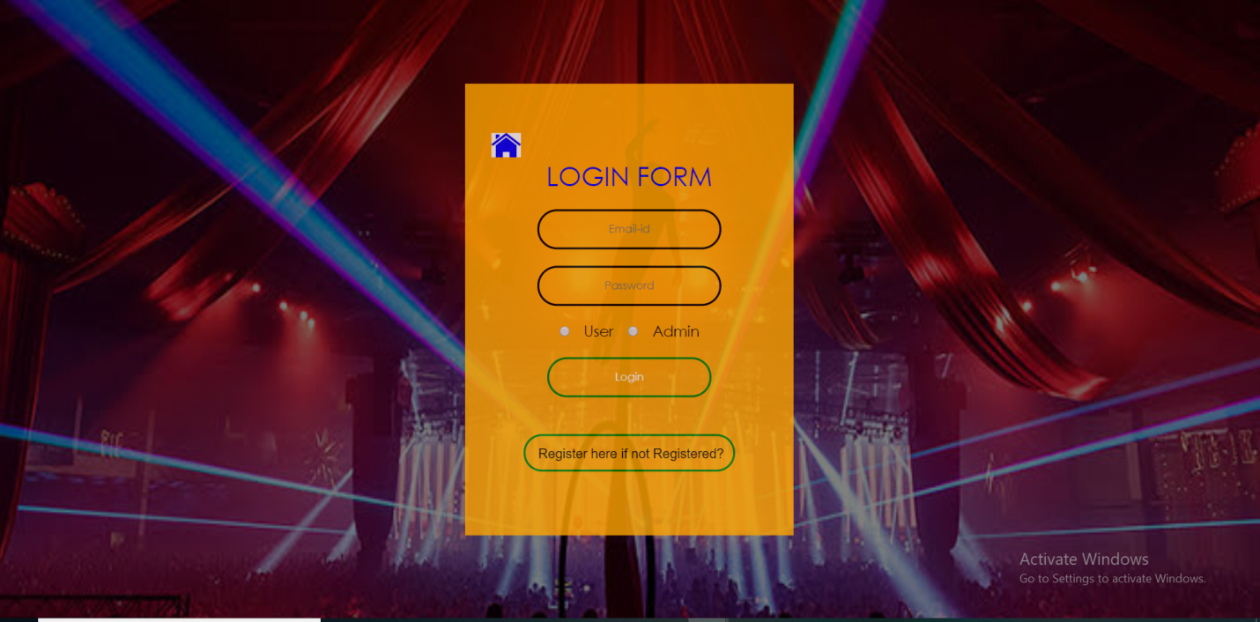
INPUT – OUTPUT SCREENS
Fig.6.1[View of Home Page]
Fig.6.2[View of Login Page]

Slide 18
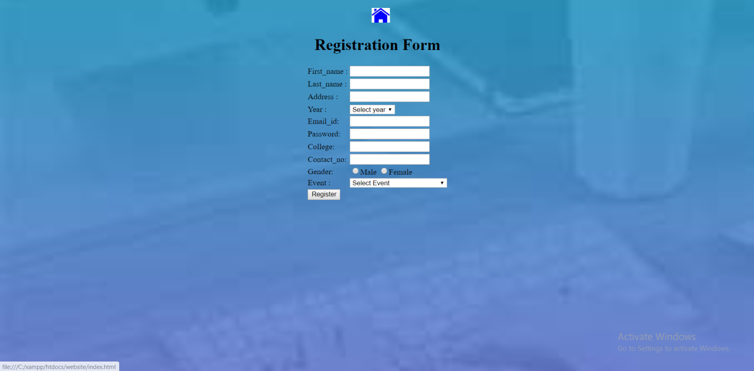
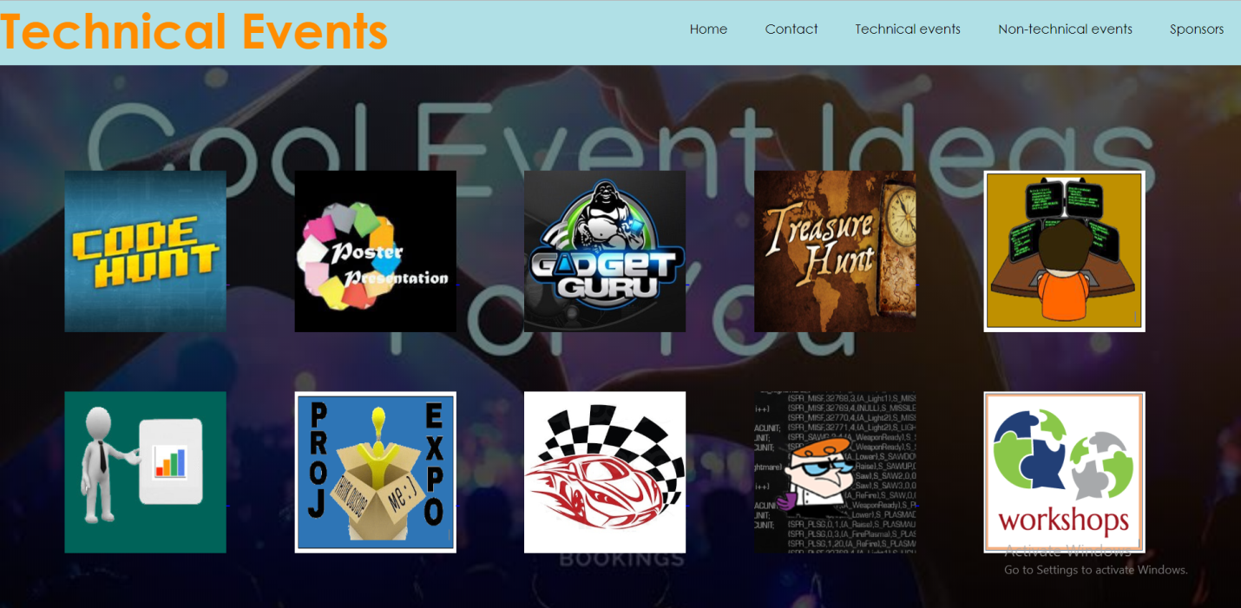
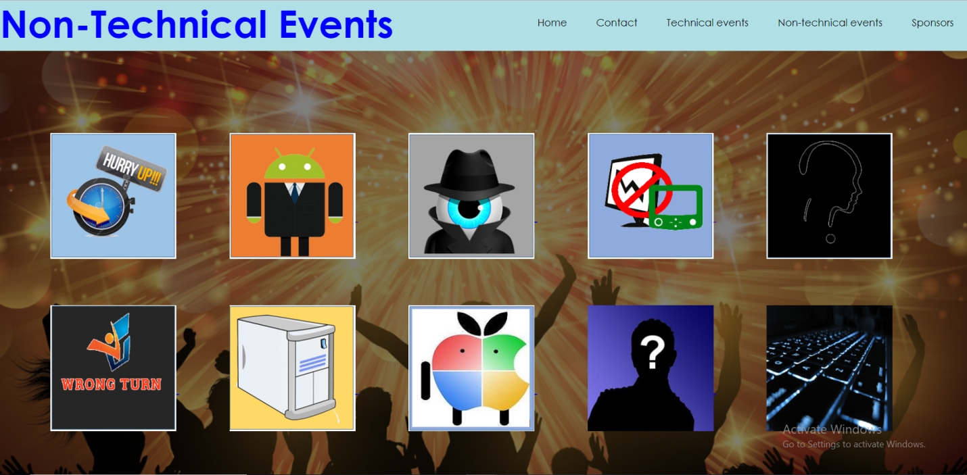
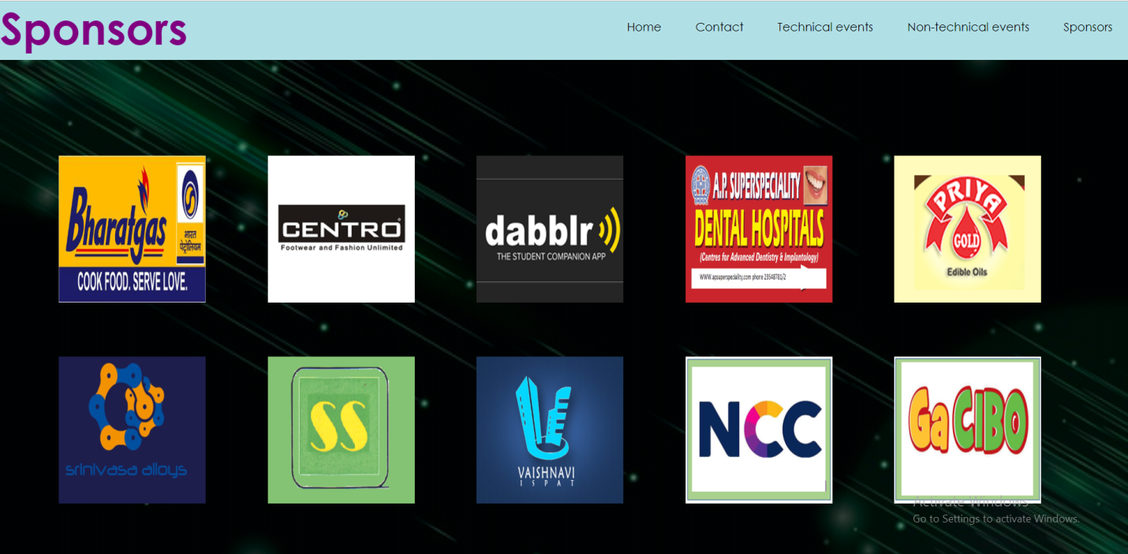
Fig.6.3[View of Registration Page]
Fig.6.5[View of Technical Events Page]

Slide 19
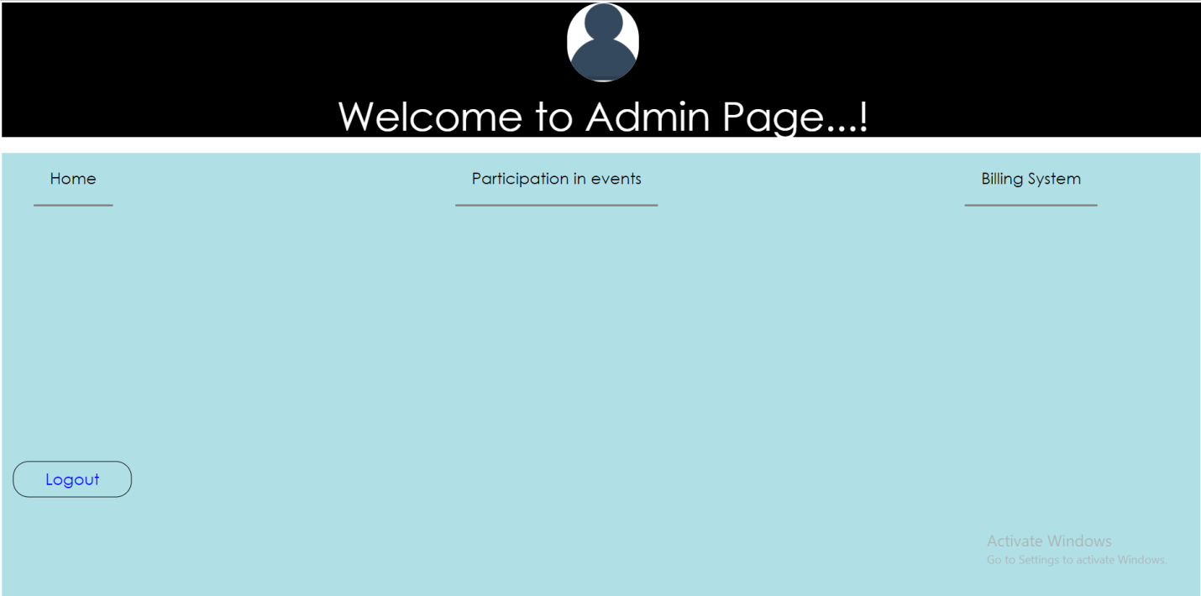
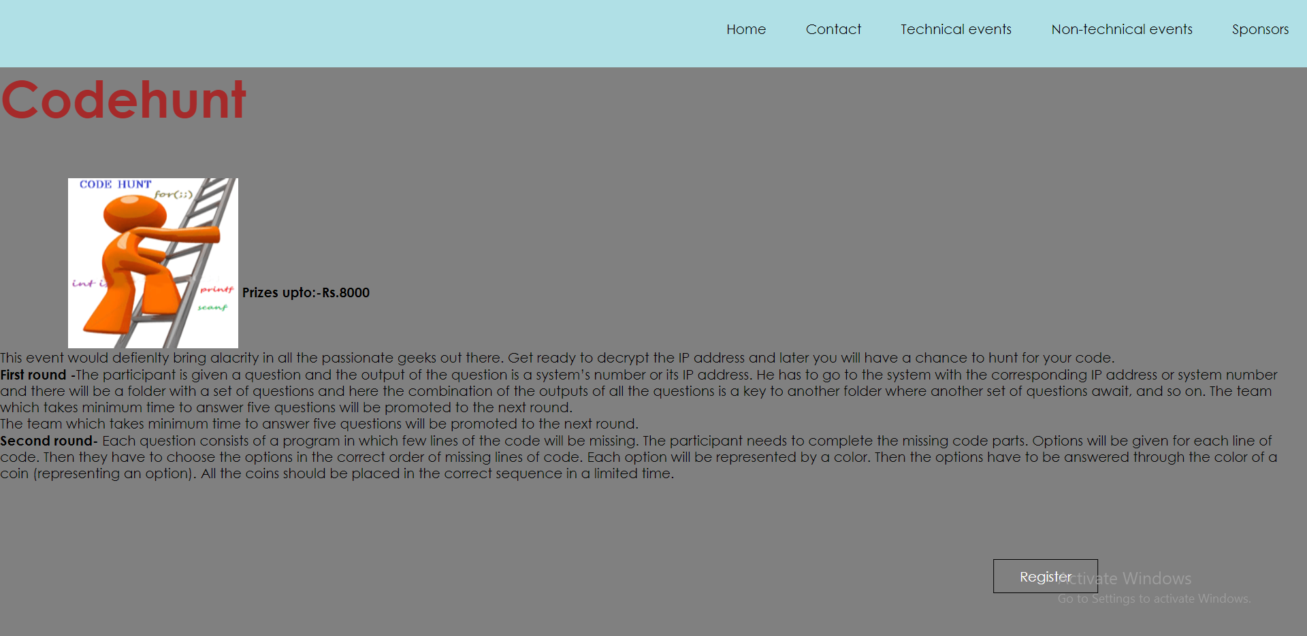
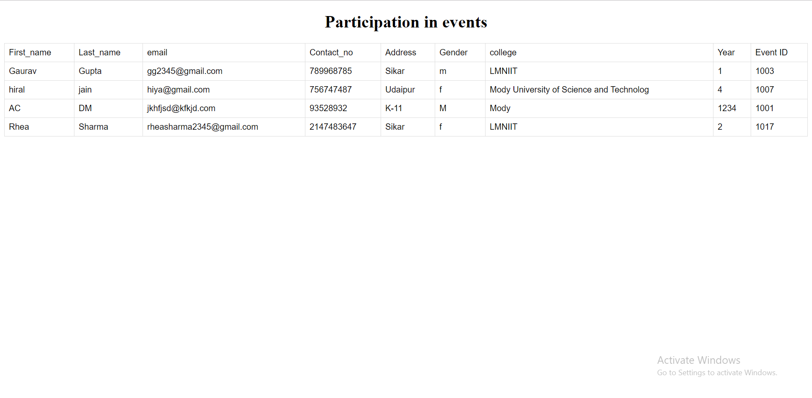

Slide 20
CONCLUSION This Project Leads To The The New Site For Students And Our College Which Provide Effective Intercommunication Of Fests. The Students Will Get A Better Medium For Getting Events And Fests Schedules. LIMITATIONS:- As The Members Of This Project We Faced Many Problems In Making This System In Sending And Fetching The Details Of The User In And From The Database And Also We Have Faced Those Challenges Which We Were Facing During The Sending And Fetching The Records Of The User and From The Database. SCOPE FOR FUTURE WORK:- The scope of this project includes a user interface to windows as well as a backend that will emulate some of its behavior. College fest management is the project to manage the technical and cultural fests organized in a college. This project generally relates to a system and method to schedule fests and more particularly, to a system and method for scheduling such as constraints by timing, conflicts, availability or other factors. This project leads to provide the user especially the student the reliability in registering the events at one place rather to go for each of webpage about events and in future basically this project will be used by our college for managing the fests that are taken place in our college so,that students can register easily for the events and fest are being organized in our college. This project leads to provide the user especially the student easiness in registering for the particular event in that type of fest.

Slide 21
References
1.^ Ramez Elmasri and Shamkant B. Navathe “Database Systems” , Pearson Education,2013
2.^ Korth and Schilberschatz “Database System Concepts” ,Tata McGraw Hill,2005,5th edition
3.^ Raghu Ramakrishnan “Database Management Systems” ,Tata McGraw Hill,2008,3rd edition
4.^ G.W. Hansen and J.V. Hansen “Database Management and Design”, Prentice Hall,2000,2nd edition
5.^ Christopher J.Date “An Introduction to Database Systems”, Pearson Publications,2003,8th edition
6.^ Refsnes Data “W3 Schools” https://www.w3schools.com

Slide 22
THAnk you

